Slide 1

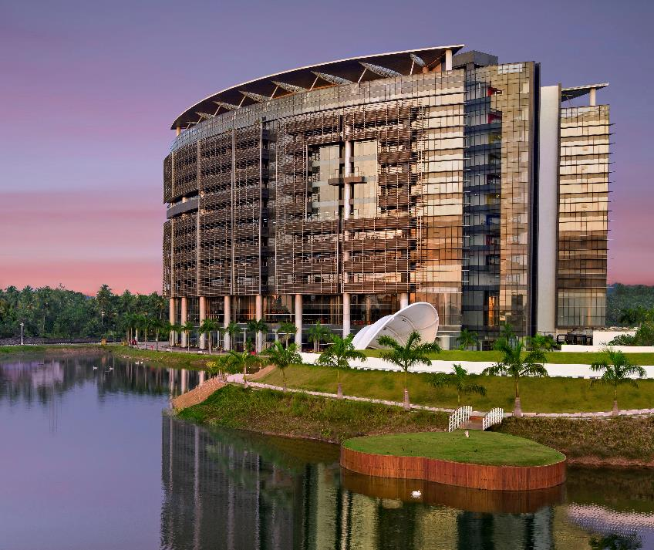
DOCKER KUBERNETES
AKHIL MURALI AMITHA MARY BENNY DEVIKA BIJO MEENAKSHI SAJEEVAN
GOLDEN EAGLES

Slide 2
Problem Statement
To solve the issue of inconsistency between different environments in software development and deployment.

Slide 3
Virtual Machine
Defined as an emulation of the computer systems in computing.
It is based on computer architectures.
It gives the functionality of physical computers.
The implementation of VM may consider specialized software, hardware, or a combination of both.
There are two types of Virtual Machine,
Process virtual machines
System virtual machines

Slide 4
Advantages
No protection problems because each virtual machine is completely isolated from all other virtual machines.
Provides an instruction set architecture that differs from real computers.
Easy maintenance, availability and convenient recovery.

Slide 5
Disadvantages
Virtual machines are not as efficient as a real one when accessing the hardware.
Running VM software on top of the host operating system means that it will have to request access to storage and memory from the physical device.

Slide 6
Docker
Open-source centralized platform
Designed to create, deploy, and run applications.
Docker uses container on the host's operating system to run applications.
Containers ensure that our application works in any environment like development, test, or production.

Slide 7
Why Docker?
•Allows us to easily install and run software without worrying about setup.
•To eliminate machine problems, when working on code together with co-workers.
•To run and manage apps in isolated containers for better compute density.
•Since docker is not only used for the deployment, but it is also a great platform for development.

Slide 8
Docker Features
Easy and Faster Configuration
Increase productivity
Application Isolation
Services
Security Management

Slide 9
Components
3 main components
Docker client
Docker Host
Docker Registry

Slide 10
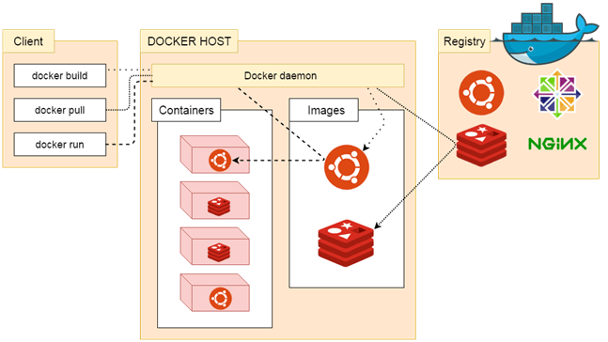
Client-Server architecture

Slide 11
Docker Client
Docker client uses commands and REST APIs to communicate with the Server.
Uses Command Line Interface (CLI) to run the following commands,
docker build
docker pull
docker run

Slide 12
2. Docker Host
Used to provide an environment to execute and run applications.
It contains the docker daemon, images, containers, networks, and storage.

Slide 13
3. Docker Registry
Manages and stores the Docker images.
Two types of registries are,
Pubic Registry - Public Registry is also called as Docker hub.
Private Registry - It is used to share images within the enterprise.

Slide 14
Dockerization process
Dockerfile Creation
Creating a Dockerfile.
Contains instructions to build the Docker image ,what files to copy into the image, which commands to run, and more.

Slide 15
2.Build Docker Image
Build the Docker image using the Docker build command.
This command reads the Dockerfile
Creates a new Docker image based on the instructions.

Slide 16
3.Running the Docker Image
After the Docker image is built, it can be run as a Docker container.
Docker containers are instances of Docker images that can be started, stopped, and deleted as needed.
When a Docker container is started, it runs in an isolated environment that has its own file system, network, and resources.

Slide 17
4. Docker Compose
A tool that allows you to define and run multi-container Docker applications.
With Docker Compose, you can specify the Docker images to use, the configuration for each container, and how they should communicate with each other.

Slide 18
5.Push Docker Image to Registry
A Docker registry is a centralized repository for storing and distributing Docker images.
Docker image is pushed to a Docker registry, such as Docker Hub, so that it can be easily pulled and used by other developers or systems.

Slide 19
Advantages
It runs the container in seconds instead of minutes.
It uses less memory.
It provides lightweight virtualization.
It does not a require full operating system to run applications.
It uses application dependencies to reduce the risk.
Allows you to use a remote repository to share your container with others.
It provides continuous deployment and testing environment.

Slide 20
Disadvantages
It increases complexity due to an additional layer.
Difficult to manage large amount of containers.
Docker is not a good solution for applications that require rich graphical interface.

Slide 21
CONTAINER
ORCHESTRATION

Slide 22
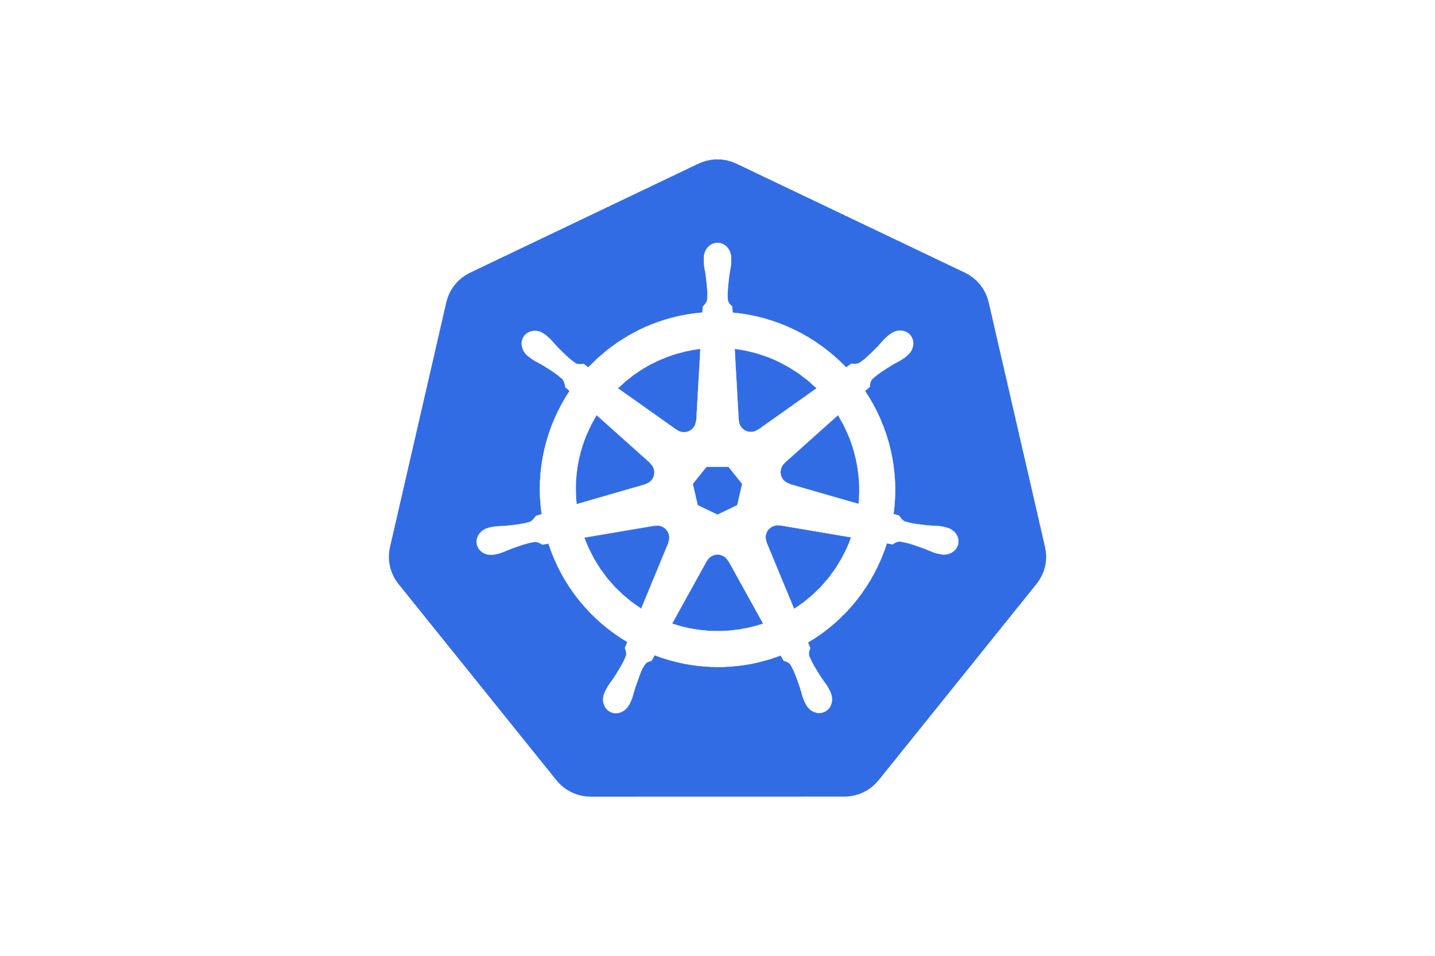
KUBERNETES
Container Orchestration tool
Managing and Automating Containerized Workloads
Orchestrates the infrastructure to handle the changing workloads

Slide 23
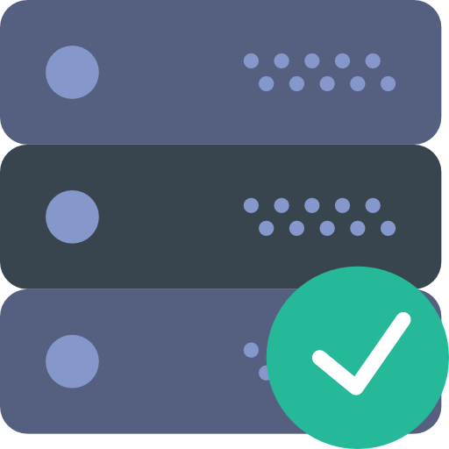
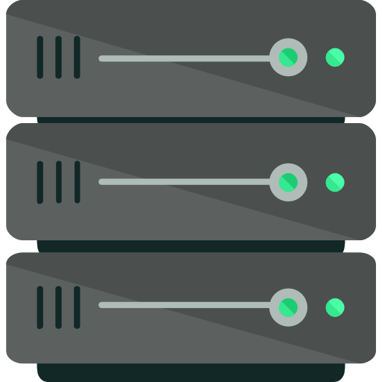

AUTO-SCALE
AUTO-HEAL

Slide 24
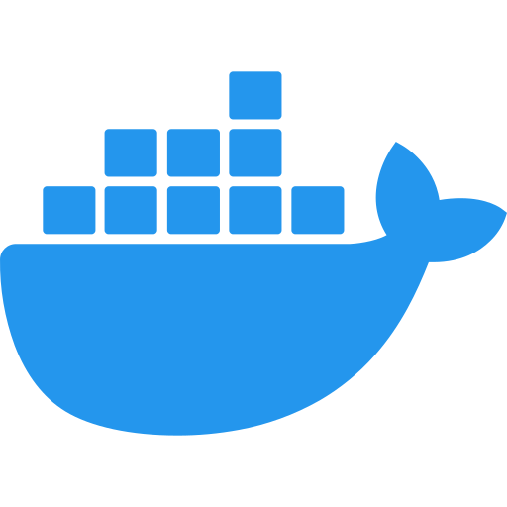
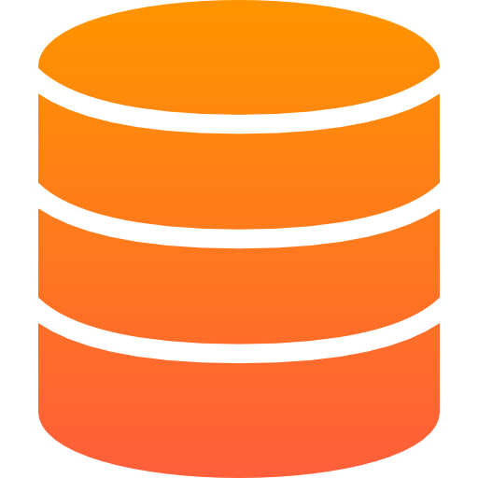
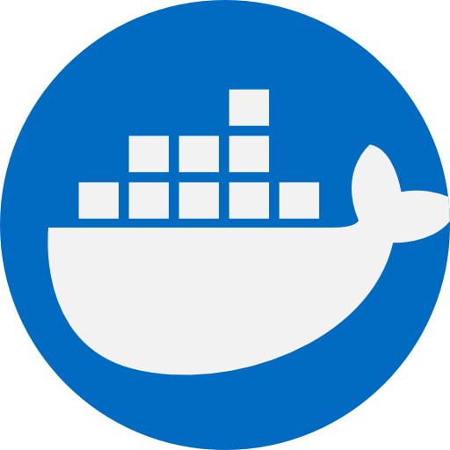
ARCHITECTURE
MASTER
UI
API Server
API
Controller Manager
CLI
Scheduler
MASTER NODE
WORKER NODE
VIRTUAL NETWORK
ETCD
Virtual Network
WORKER
KUBELET
KUBELET
KUBELET

Slide 25
ARCHITECTURE
MASTER
UI
API Server
API
Controller Manager
CLI
Scheduler
MASTER NODE
WORKER NODE
VIRTUAL NETWORK
ETCD
Virtual Network
WORKER
KUBELET
KUBELET
KUBELET

Slide 26
ARCHITECTURE
MASTER NODE (CONTROL PLANE)
processes that are absolutely necessary to run and manage the cluster
API Server
entry point to the kubernetes cluster
Controller Manger
keeps an overview of what's happening in the cluster
Scheduler
scheduling containers on different nodes based on the workload
ETCD
key value storage which basically holds at any time the current state of the kubernetes cluster
MASTER
UI
API Server
API
Controller Manager
Virtual Network
Scheduler
CLI
ETCD
WORKER
KUBELET
KUBELET
KUBELET

Slide 27
MASTER
UI
API Server
API
Controller Manager
CLI
Scheduler
ETCD
ARCHITECTURE
WORKER NODE
Kubelet
Communicates with master node
Pod
Smallest Deployable Units
Kube-Proxy Service
Maintains protocol on nodes
Permanent IP Address
Virtual Network
SERVICE
SERVICE
SERVICE
KUBELET
KUBELET
KUBELET
WORKER

Slide 28
ARCHITECTURE
MASTER
UI
API Server
VIRTUAL NETWORK
API
Controller Manager
CLI
Scheduler
Enables Master Worker nodes talk to each other
Creates one unified machine
ETCD
Virtual Network
WORKER
KUBELET
KUBELET
KUBELET

Slide 29
MASTER
ARCHITECTURE
UI
API Server
API
Controller Manager
CLI
Scheduler
ETCD
Virtual Network
WORKER
KUBELET
KUBELET
KUBELET

Slide 30
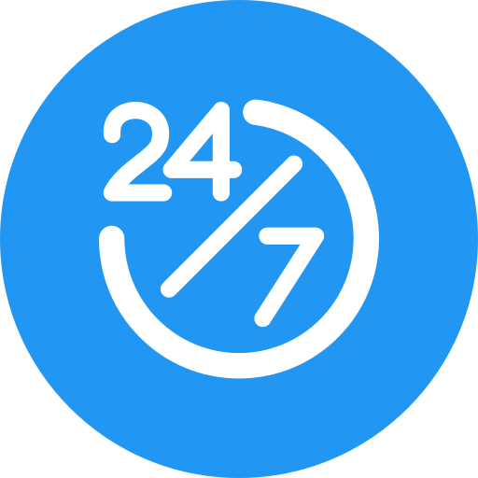
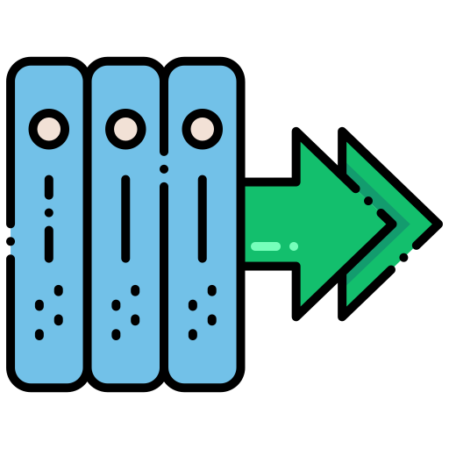

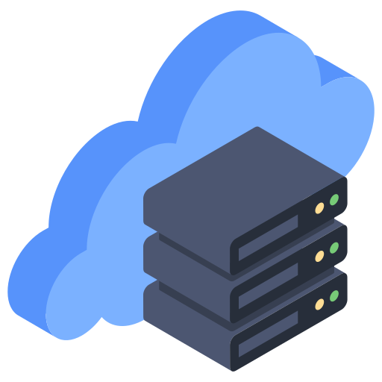

ADVANTAGES
High Availability
Scalability
Load Balancing
Self Healing Infrastructure
Efficient Use of Cloud Resources

Slide 31

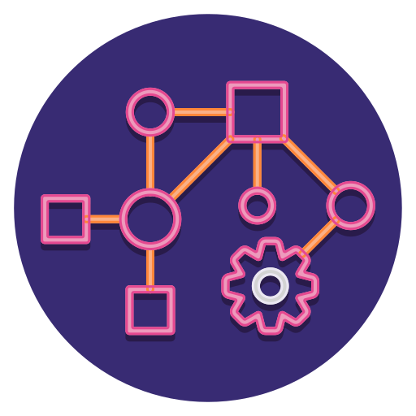


DISADVANTAGES
Overkill for simple applications
Complex Architecture
Talented Experts
Migration

Slide 32
THANK YOU
Akhil Murali (akhil.murali@ust.com)
Amitha Mary Benny (amithamary.benny@ust.com)
Devika Bijo (devika.bijo@ust.com)
Meenakshi Sajeevan (meenakshi.sajeevan@ust.com)

